Slide 1
IPL Dashboard
File created on: 6/1/2022 10:39:17 AM

Slide 2
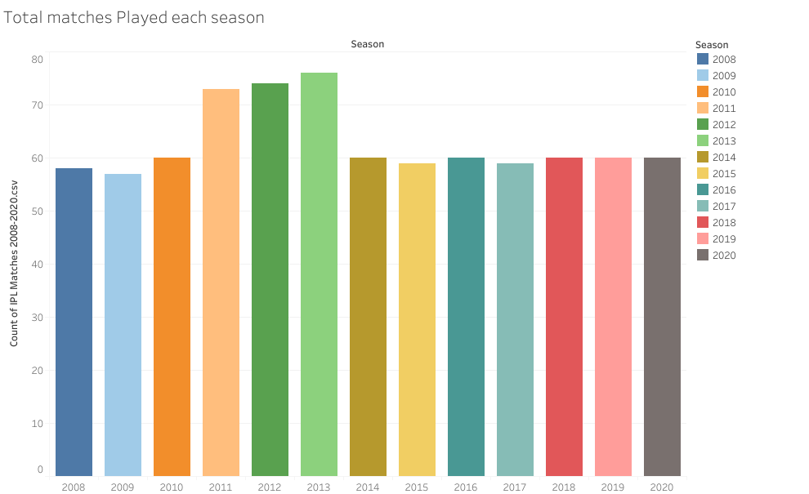

Slide 3
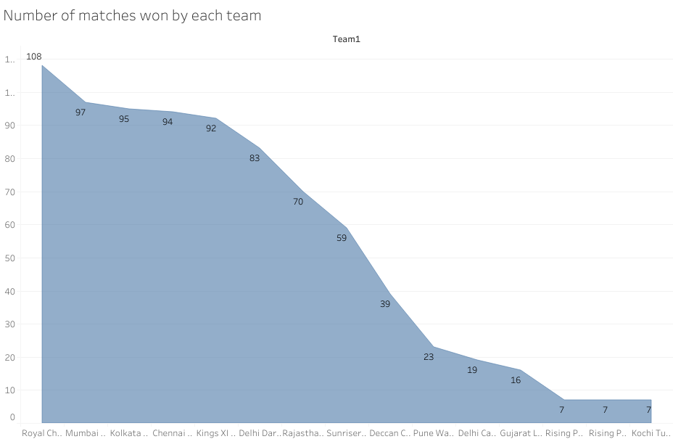

Slide 4
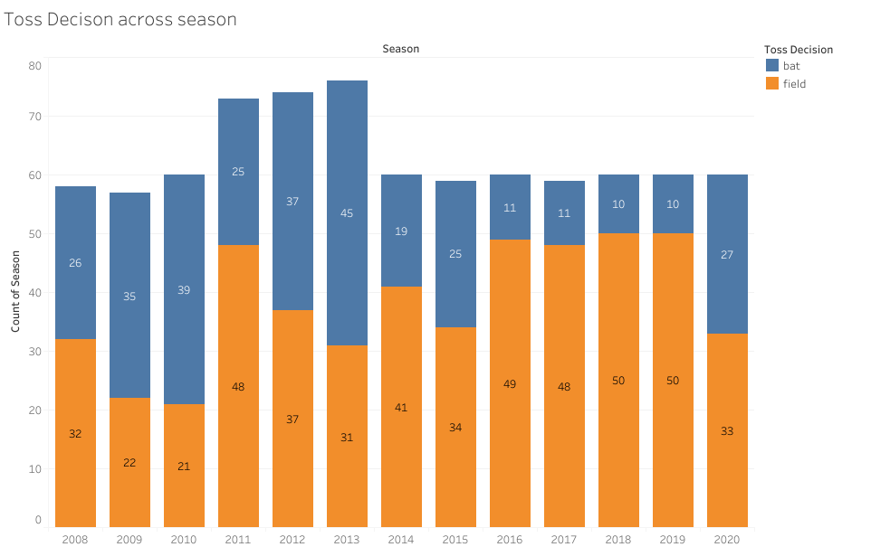

Slide 5
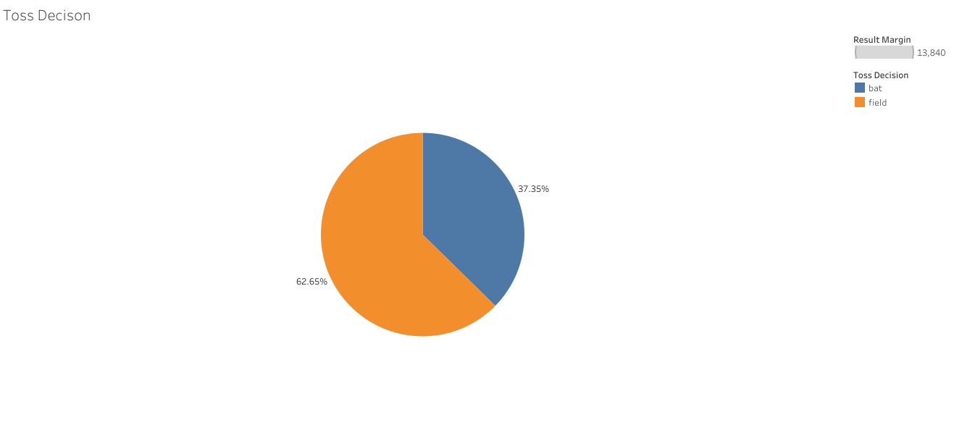

Slide 6
